Slide 1

Threads APP
Presented By
Kushal Hirapara & Krishna Ramani

Slide 2
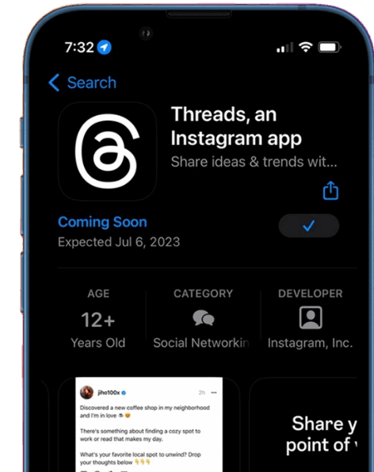
What Is
Threads Application
Threads is a social media app. It is designed for close friends and family, and it allows users to share photos, videos, and text messages with a select group of people.

Slide 3
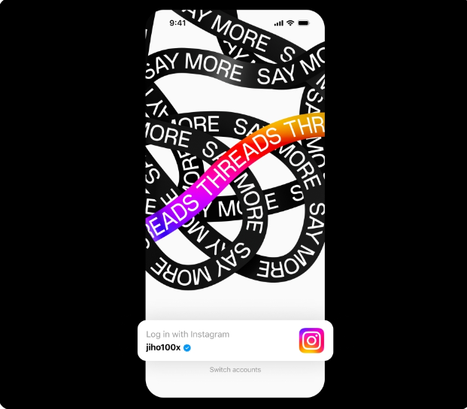

Birth Of Threads Meta App
6:00
Threads is the newest app released by Meta, which will be available starting July 6, 2023, and will directly compete with the social networking platform Twitter in the United States.

Slide 4

CEO OF Threads Meta App
The CEO of Threads Meta app is Mark Zuckerberg. He is also the CEO of Meta Platforms, the parent company of Threads Meta.

Slide 5





One In More
Threads Meta is a standalone app, but it can share posts and Stories to Instagram and Facebook, and it can also be shared in chat groups on WhatsApp or Messenger.

Slide 6

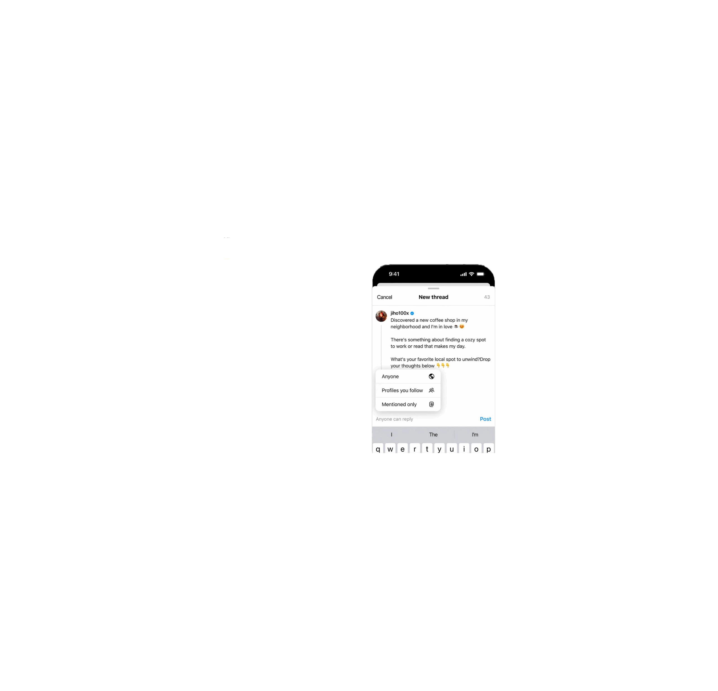
You log in using your Instagram account and posts can be up to 500 characters long and include links, photos, and videos up to 5 minutes in length.
Close friends and family
Real-time chat
Stories
Features Of Threads App
Location sharing
Sticker packs
Customization
Privacy settings
Security features

Slide 7

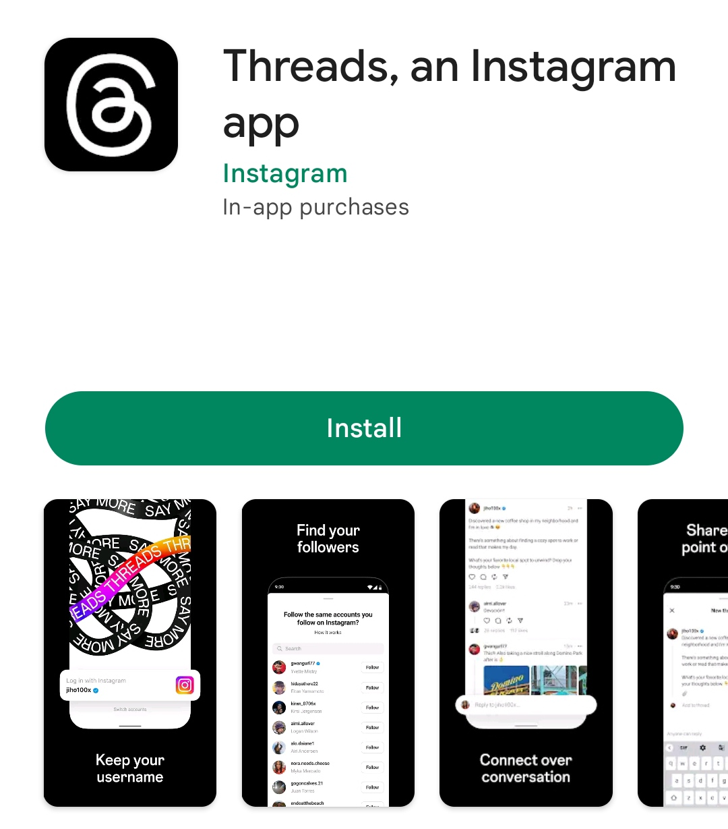
First Day Download Count
30 Millions
According to reports, Threads Meta app was downloaded more than 30 million times in its first day of launch. This makes it one of the most rapidly downloaded apps in history.

Slide 8


Competitor
Threads provides a microblogging experience that closely resembles Twitter. Users can repost, reply to, or quote a thread, and they can view the number of likes and replies a post has received.
Elon Mask
CEO of Twitter

Slide 9

Data Linked To You
Treads Meta App
Twitter
The following data may be collected and linked to your identity:
The following data may be collected and linked to your identity:
The following data may be collected and linked to your identity:
Health & fitness
Purchases
Purchases
Location
Financial Info
Location
Contact Info
Contacts
Contact Info
Contacts
User Content
Search History
User Content
Search History
Browsing History
Identifiers
Browsing History
Identifiers
Usage Data
Diagnostics
Usage Data
Sensitive Info
Diagnostics
Other Data

Slide 10
Thank You
To All

